Slide 1
FEMALE STERILISATION
PRESENTED BY
DR. J. CHITRA M.D., D.G.O., D.N.B., MNAMS
KKGMCH
ASARIPALLAM.

Slide 3
BIO DATA
Dr. J. CHITRA M.D., D.G.O., DN.B., MNAMS
Associate Professor in Kanyakumari Govt. Medical College
- Department of O&G
Past President - Nagercoil OG Society
- MBBS - Stanley Medical College - Chennai.
1989- D.G.O - Madurai Medical College.
1994- MD - Kasthuribhai Govt. Medical College
- Chennai

Slide 4
Introduction
Worldwide Female Sterilization is the most popular and effective method of contraception.
In addition to being permanent, it is safe and relatively free from side effects.
It is the most commonly accepted method among eligible couples.

Slide 5
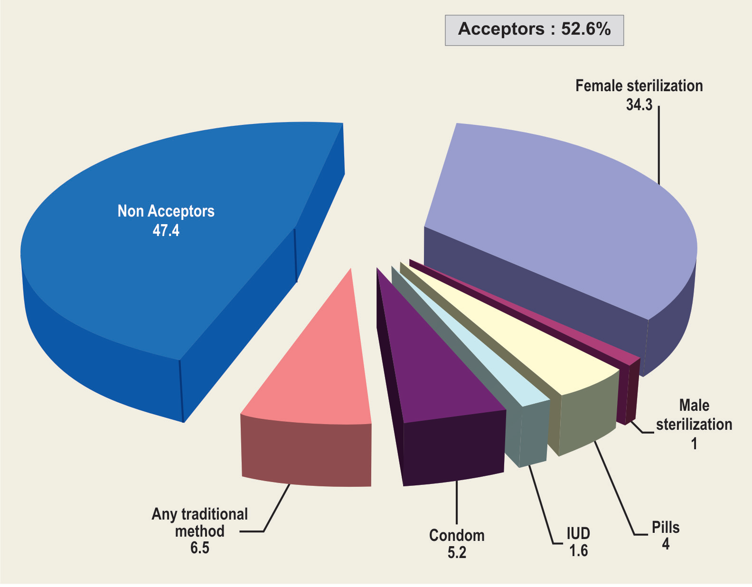

Slide 6
National population Policy is to address the unmet need for contraception to bring down the Total Fertility Rate to 2.1 by 2012

Slide 7
Methods of Female Sterilization
Interval
Laparoscopic
Electrocoagulation (Mono and Bi -Polar)
Falope Ring
Hulka Clip
Filshie Tubal Ligation System
Hysteroscopy
Essure
Adiana
Post Partum/ Labor & Delivery
Pomeroy
Parkland
Irving
Uchida
Filshie Tubal Ligation System

Slide 8
In India, female sterilisation is being done by Minilap tubectomy and Laparoscopic tubal ligation.
Though both methods are equally safe and effective, a trained Gynaecologist or surgeon is required for lap.
Sterilisation whereas minilap can be performed by a trained MBBS doctor.
It has been also observed that states providing minilap tubectomy on a regular basis throughout the year have achieved replacement fertility levels. for example states like Kerala, Karnataka, Tamil Nadu and Andhra Pradesh.

Slide 9
When to Perform Post-Partum Sterilization
Postpartum Sterilization to be performed between 24 to 48 hours provided there are no complication. The likelihood of postpartum haemorrhage is also reduced after 12–24 hours, thus increasing safety of the procedure for the woman.
A delay of up to 7 days may be justified in situations which demand a more accurate assessment of the baby’s chances for survival.

Slide 10
Failure, may be due to abnormalities of the fallopian tubes; procedural errors and reopening of the tube (recanalization) during the healing process (Soderstrom 1986).

Slide 11
The presence of early, undetected pregnancy at the time of the procedure may be perceived as a failure and must be ruled out carefully.

Slide 12
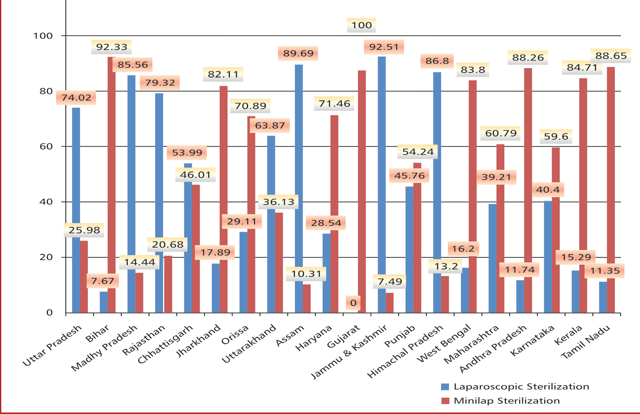

Slide 13
Advantages
Laparoscopic sterilization is gaining popularity all over the world as it has a number of advantages:
Subumbilical scar is small and nearly invisible.
It is highly reversible, with a success rate of 70% or more.

Slide 14
Disadvantage
The equipment is expensive and maintenance is not easy.
Experienced personnel is required to perform this operation.

Slide 15
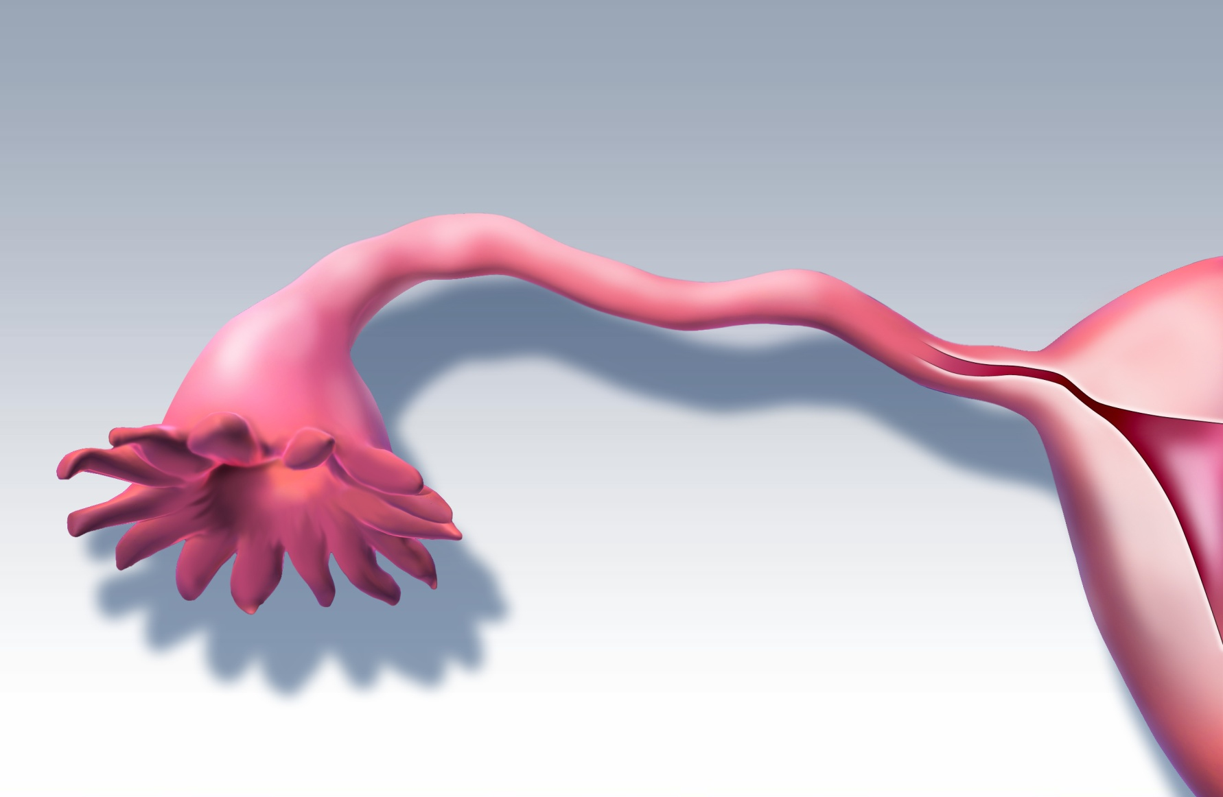
Anatomy
Ampulla
Isthmus
Infundibulum
Fimbria

Slide 16
Methods of Female Sterilization
Falope Ring (Yoon band)
Laparoscopic
Mechanical occlusion invented in 1974
Tubal occlusion accomplished by placing a silicone band around the tube in a similar fashion to Pomeroy-technique
Thicker tubes may be problematic
May not be suited for postpartum
Complications
Increased patient discomfort during recovery – large area of necrosis

Slide 17
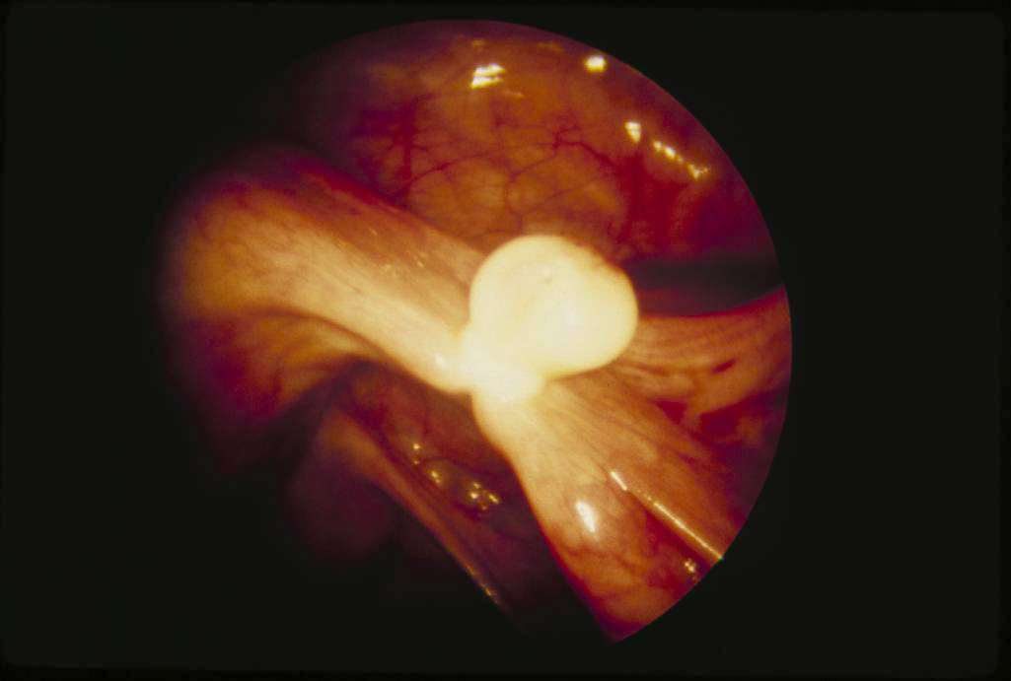
Methods of Female Sterilization
Falope Ring/Yoon Band

Slide 18
Methods of Female Sterilization
Hulka Clip
Laparoscopic
Tubal occlusion is accomplished by placing a spring clip (plastic and gold plate) across the fallopian tube
Hulka clip has limited tubal capacity
Not magnetically inert
Potential patient allergy due to gold plate

Slide 19
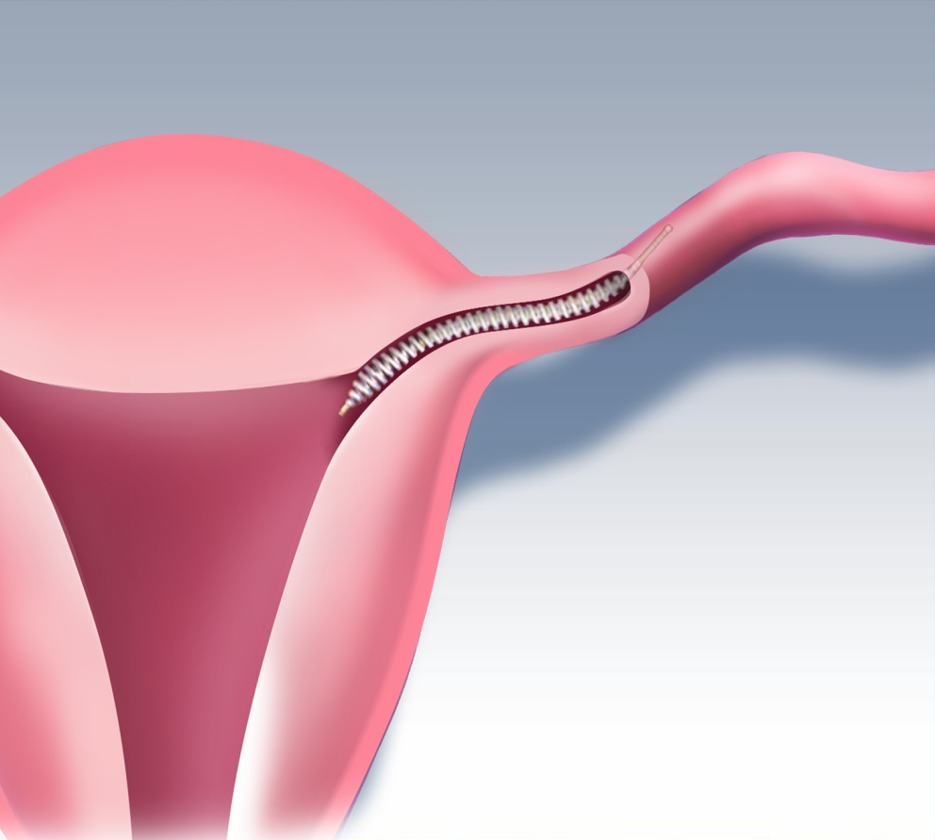
Methods of Female Sterilization
Essure
Hysteroscopic (Hospital and Office-based procedure)
Approved in 2002
Micro-insert placed into each tube, PET fibers stimulate in-growth over several weeks
86% Success Rate for 1st time placements of micro-inserts
3 months of alternative contraception until HSG procedure confirms occlusion
Not suitable for patients with known allergies to contrast media or hypersensitivity to nickel
Irreversible
May limit a patients ability to have in vitro fertilization, should patient change her mind
May limit the ability to perform endometrial ablation in the future
ACOG does not recommend concomitant endometrial ablation

Slide 20
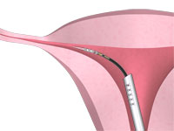
Methods of Female Sterilization
Adiana
Hysteroscopic (Hospital and Office-based procedure)
Approved in 2009
Catheter delivers low RF energy for one minute then a 3.5 mm non-absorbable silicone elastomer matrix is placed in each tubal lumen
3 months of alternative contraception until HSG procedure confirms occlusion

Slide 21
Methods of Female Sterilization
Monopolar Coagulation
Laparoscopic
Proposed in 1937 by Anderson
Complications
Bowel Burn
Bleeding
Longer portion of tube is damaged
Failures and ectopic pregnancy
Transection is frequent
Failure Rate: 7.5/1000 (.07-.75%)¹
¹ Peterson LS Contraceptive use in the United States: 1982 -90. Advance Data: From Vital Health Statistics February 1995; 260 1-8

Slide 22
Methods of Female Sterilization
Bipolar Coagulation
Laparoscopic
Introduced in 1973 by Jacques Rioux
Benefits
Most common method of laparoscopic sterilization
Burn several locations along the tube
Complications
Formation of uteroperitoneal fistulas
High rate of ectopic pregnancy
Potential for bowel burns
Reversals are potentially more difficult due to the extent of tube damage
Failure Rate: 24.8/1000¹ (.2-2.5%)
1 Peterson HB, et al. The risk of pregnancy after tubal sterilization: Findings from the U.S. Collaborative Review of Sterilization. Am J obstet. Gynecol. 1996; 174 (4):1161-1170

Slide 23
Complications
Complications are uncommon but when they do occur, they are usually in the hands of inexperienced personnel:
Abdominal wall emphysema due to wrong placement of the needle.
Bleeding from superior epigastric vessel by trocar injury.

Slide 24
Tearing of the mesosalpinx and bleeding.
Uterine perforation.
Wrong application of the ring, e.g. putting the ring
on round ligament / meso salpinx / utero –
ovarian ligament, will cause operation failure.
Failure rate varies between 0.4 and 2.5%.
Whereas cauterization carries a failure of 0.8%,
Hulka clip has a failure rate of 2.3%, and Falope
ring 0.8%. Most failures occur within 2 year of
operation. At the end of 10 years, failure is
reported in 1.8%.

Slide 25
Spontaneous recanalization occurs if
cauterization is incomplete.
Ectopic pregnancy is reported in 0.2 to 0.3%.
Hydrosalpinx formation if the tube is occluded
at 2 places some distance apart.

Slide 26
Studies and Findings
Sterilization: A Review of World Experience
Method
Patients
(No.)
Failure
Rate
Bipolar Coagulation
2,267
2.48%
Unipolar Coagulation
1,432
0.75%
Yoon Band
3,329
1.77%
Hulka Clip
1,595
3.65%
Interval Partial Salpingectomy
425
2.01%

Slide 27
Contraindications
The contraindications are not many:
In a patient with a cardiac or pulmonary disease, head low position and CO₂ are contraindicated.
Previous abdominal surgery exposes the patient to the risk of intestinal trauma in case parietal adhesions are present.

Slide 28
Puerperal cases. The fallopian tubes are
oedematous and vascular and may easily get
torn. The uterus is soft and can get easily
perforated with the uterine manipulator.
Extreme obesity, diaphragmatic, or umbilical
hernia.
In PID, fallopian tubes may not be easily visible
amongst the adhesions.

Slide 29
Due to associated morbidity, the government of India has forbidden laparoscopic sterilization combined with medical termination of pregnancy (MTP) and in the puerperal period.

Slide 30
Failure rate in Govt. & Private Hospital
YEAR | No. DEATH | FAILURE | GOVERNMENT HOSPITAL |  | PRIVATE HOSPITAL
 |  |  | PS | LS | PS | LS
2009 - 2010 | NIL | 4 |  | 2 | 2
2012 - 2011 | 1 | 1 | 1
2011 -2012 | NIL | 8 | 4 | 3 | 1
2012 - 2013 | NIL | 7 | 5 |  | 2

Slide 31
Methods of Female Sterilization¹
Procedure | Timing | Technique
Minilaparotomy | Post Partum Post Abortion Interval | Mechanical Devices (Clips, Rings) Tubal Ligation or Excision
Laparoscopy | Interval Only | Electrocoagulation (Unipolar, Bipolar) Mechanical Devices (Clips, Rings)
Laparotomy | In conjunction with other surgery (Cesarean section, salpingectomy, ovarian cystectomy, etc.) | Mechanical Devices (Clips, Rings) Tubal Ligation or Excision
¹ Female Sterilization In: Landry E, ed. Contraceptive Sterilization: Global Issues and Trends. New York: Engender Health; 2002: 139-160
Since 2002, hysteroscopic methods are available and can be performed interval-only (Essure and Adiana).

Slide 32
Note : Tubectomy does not increase the incidence of ectopic pregnancy.
However, if a woman does become pregnant after tubectomy, she is more likely to have an ectopic pregnancy. (Pollack 1993).

Slide 33
Case Selection
Self-declaration by the client will be the basis for compiling this information.
Clients should be married (including ever-married).
Female clients should be below the age of 49 years and
above the age of 22 years.
The couple should have at least one child, whose age is
above one year, unless the sterilization is medically indicated.

Slide 34
Clients must be in a sound state of mind, so as
to understand the full implications of sterilization.
Mentally ill clients must be certified by a
psychiatrist, and a statement should be given by
the legal guardian/spouse regarding the soundness
of the client’s state of mind.

Slide 35
Counselling and Informed Consent
Informed consent is needed, which is given and signed by the client herself.

Slide 36
Post-Procedure Counselling
This is usually done after surgery before discharging client from the facility. Some elements of thiscounselling, however, should have been done earlier and reinforced at this time (e.g., pain at the incisionsite for a few days and other common side-effects).
The focus of post-procedure counselling is however on warning signs (e.g., fever, persistent abdominal
pain, bleeding or pus at the incision site) which indicate the need for a quick return to the clinic

Slide 37
In addition, the client should be:
Informed about whom to contact, if she develops any problems ( warning signs ) or has any concerns, and
Given written information (e.g Follow-up Card ) on the dates of her follow-up visits.

Slide 38
Consent for tubectomy should not be obtained when physical or emotional factors may compromise a client’s ability to make a carefully considered decision about contraception.

Slide 39
There is no requirement for spousal consent legally, but because tubectomy is a permanent procedure, a joint decision usually will mean more satisfied clients and fewer complaints to health workers following the surgery. It may be advisable to find out how the spouse feels about adopting the method. If the spouse is not in favour of it, the provider should caution the client about going ahead with the procedure.

Slide 40
Medical Eligibility Criteria
With proper counselling and informed consent most women an can have female sterilization safely. However, certain conditions or circumstances require some precautions either in timing of the procedure or selection of the facility where the procedure is to be performed.
A targeted medical history, physical examination and laboratory investigations need to be completed to ascertain eligibility for surgery.

Slide 41
The World Health Organization (WHO) has developed: Medical Eligibility Criteria” (MEC) a system for assessing how, when and where minilap tubectomy procedures should be performed and categorizes the various medical conditions into:

Slide 42
A (Accept),
C (Caution),
D (Delay), and
S (Special)
In order to maximize access to quality minilap tubectomy services, the WHO Eligibility Criteria have been adapted by countries according to need. The WHO MEC, modified as per Indian conditions is as follows:

Slide 43
A (Accept), C (Caution), D (Delay), and S (Special)
All women can have female sterilization. No medical conditions prevent a woman from undergoing female sterilization, but may limit when, where, or how the female sterilization procedure should be performed.

Slide 44
ACCEPT:
The majority of clients are classified under ‘Accept’, and the procedure can be performed in most clinical settings.

Slide 45
CAUTION:
Clients identified with conditions requiring ‘Caution’ can be provided minilap tubectomy in routine setting but with extra preparation and precautions, as required. The conditions included in this category
are.
1 Moderate iron deficiency anemia (Hb 7 - 10 g/dl)
2 Previous abdominal or pelvic surgery

Slide 46
3 Obesity
4 Controlled BP (140-159/ 90-99)
5 Uncomplicated heart disease
6 History of ischemic heart disease
7 Stroke
8 History of cerebro-vascular accident
9 History of deep vein thrombosis or pulmonary embolism
10 Epilepsy
11 Depressive disorders
12 Current breast cancer
13 Uterine fibroids
14 PID without subsequent pregnancy
15 Uncomplicated diabetes
16 Hypothyroidism
17 Mild cirrhosis
18 Liver tumors
19 Kidney disease
20 Thalassemia and Sickle Cell Disease

Slide 47
DELAY:
Delay means postpone minilap tubectomy. These conditions must be treated and resolved before female sterilization can be performed.
1 Current pregnancy
2 7 – 42 days postpartum
3 Pregnancy with severe pre-eclampsia or eclampsia
4 Post partum or post abortion complications ( infection, hemorrhage and trauma )
5 Current DVT/PE
6 Major surgery with prolonged immobilization
7 Abdominal skin infections
8 Current ischemic heart disease

Slide 48
9 Lung disease like pneumonia
10 Systemic infection
11 Unexplained vaginal bleeding
12 Large collection of blood in uterus
13 Malignant trophoblastic disease
14 Cancers of the genital tract
15 Current PID
16 Current purulent cervicitis, Chlamydia, gonorrhea
17 Current gall bladder disease
Give the client another contraceptive method until till the procedure can be performed.

Slide 49
SPECIAL:
Certain women have conditions that make operation difficult or increase the risks. Women with the
following conditions should have their surgery in a well-equipped facility, with availability of general
anaesthesia and other back- up for emergency.

Slide 50
1 Conditions that increase chances of heart disease or stroke i.e. older age, smoking, high BP or diabetes
2 Blood Pressure > 160/100
3 Complicated heart disease
4 Coagulation disorders
5 Chronic lung diseases ( asthma or emphysema )
6 Endometriosis
7 AIDS
8 Pelvic tuberculosis
9 Fixed uterus due to previous surgery or infection
10 Abdominal wall or umbilical hernia
11 Post partum or post abortion uterine rupture or perforation
12 Diabetes > 20 years with organ damage
13 Hyperthyroidism
14 Severe cirrhosis of liver

Slide 51
The operating surgeon must fill in the medical record and checklist (Annexure - 4)

Slide 52
The Surgical Procedure
A full bladder increases the risk of injury during abdominal entry; therefore, immediately before the procedure, the client’s bladder should be emptied. The safest, most effective way to ensure an empty bladder is to ask the client to urinate immediately before she enters the operating theatre.
Routine use of the catheter should be discouraged, since it may raise the risk of infection. A catheter should be used only if, once the client is on the operating table, palpation or inspection of the region suggests that the bladder is full.

Slide 53
To avoid grasping the bowels along with the peritoneum, be sure to ask the client to take a deep breath before you grasp the peritoneum. Before incising the peritoneum, look at or feel a fold of the grasped tissue, to confirm that it is the translucent peritoneum only and that abdominal
contents are not adhering to it.

Slide 54
Eligibility of Providers
Any trained and empanelled MBBS doctor can provide minilap tubectomy services at an accredited
facility.
The state should maintain a district-wise list of doctors empanelled for performing sterilization operations in government institutions and accredited private /NGO facilities. The panel should be updated quarterly.

Slide 55
Other Lab Investigations
Extensive laboratory investigations are unnecessary for procedures under local anaesthesia.
Routine investigations like haemoglobin and urine analysis for albumin and sugar are necessary.
Other investigations may be conducted if indicated.

Slide 56
It is important that the tubal loop is large enough so that at least 1 cm of the tube can be excised but enough of the margin of the tube remains that it does not slip out of the suture.

Slide 57
Rapidly absorbable suture (chromic or plain catgut) is recommended, to allow the two cut ends of the tube to withdraw quickly from each other.
This reduces the risk of failure as a result of spontaneous recanalization.

Slide 58
Peritoneal closure is not necessary, as evidences has shown that the peritoneum heals by itself in 24 to 48 hours, without adhesions (Janschek et al., 2003).

Slide 59
Follow-Up
The health worker should visit the tubectomy client at home within 48 hours of discharge.
Alternatively, the client should report to the clinic.

Slide 60
The next follow-up visit should preferably occur on the seventh day after surgery (or as early as possible after 7 days) and should include an examination of the operative site, suture removal (if nonabsorbent sutures were used) and any other relevant examination as indicated .
Subsequent follow-up visit should be made after either one month or the next menstrual period,
whichever is earlier.
.

Slide 61
Subsequent follow-up visit should be made after either one month or the next menstrual period, whichever is earlier.
During this follow-up visit the staff assesses the client to determine if she has any
side effects or complications or dissatisfaction related to the surgery.
The client is treated or referred as indicated.

Slide 62
Emergency Follow Up-Clients making an emergency follow-up visit should receive immediate attention.
Staff should be alert to the possibility of internal bleeding, bowel injury or infection.
If the woman had surgery at another health facility, the medical records may not be available.

Slide 63
The staff member conducting the interview should obtain chronological information covering all events since the day of surgery.
Complications and treatment should be reported to the facility where the tubectomy was performed.

Slide 64
Failure of Tubectomy
Failure of the procedure leading to pregnancy may be due to either technical deficiency in the surgical procedure or spontaneous re-canalization.
The client should be advised to report to the facility immediately after missed periods.

Slide 65
She should be offered MTP and repeat sterilization surgery or be medically supported throughout the pregnancy if she so wishes. Ectopic pregnancy must be ruled out as tubectomy predisposes
to this condition.

Slide 66
Check the following are available / working:
• Oxygen is available and working
• Standby oxygen cylinder available
• Make sure that the oxygen cylinder key is with cylinder.
• Ensure that the suction machine and Ambu bag is available and working
• Ensure that emergency/anaphylaxis medicine tray is available.

Slide 67
Family Planning Insurance Scheme
Limit of Indemnity
Claims Arising out of Sterilization Operatio |  | Amount
A | Death at hospital/within seven days of discharge | Rs. 2,00,000/-
B | Death due to sterilization (8th –30th day from the date of discharge) | Rs. 50,000/-
C | Expenses for treatment of Medical Complications | Rs. 25,000/-
D | Failure of Sterilization | Rs. 30,000/-
D | Doctors/Facilities covered for litigations up to 4 cases per year including defence cost | Rs. 2,00,000/-

Slide 68
Thank you

